Slide 1

MARINE GUARD
by
S.K SUHANA ANJUM
Roll No. 224G1A05A7
P. MAHAMMED THANVEER
Roll No. 224G1A0546
C. PALLAVI
Roll No. 224G1A0564
Under the guidance of
Mr. C. Sudheer Kumar, M.Tech., (Ph. D)
Assistant Professor
Department of Computer Science and Engineering
Srinivasa Ramanujan Institute of Technology
Autonomous
Rotarypuram Village, B K Samudram Mandal, Ananthapuramu – 515701.
2025-2026
B - 18

Slide 2
Contents
Marine Guard
Title Justification
Abstract
Problem statement
Objectives of Project
Literature survey for objectives
Proposed Work -(Methods to be followed for proposed system)
References
GitHub Link
Queries
Srinivasa Ramanujan Institute of Technology

Slide 3
Title Justification
Marine Guard
The title “MarineGuard – River Pollution Awareness & Reporting System” is appropriate because it clearly represents the project’s purpose of protecting river ecosystems by raising awareness and enabling public reporting. “MarineGuard” suggests safeguarding water bodies, “River Pollution Awareness”. “Reporting System” shows that users can submit real-time reports with images and locations. Overall, the title reflects the system’s goal of combining awareness, monitoring, and citizen participation in line with Life Below Water.
Srinivasa Ramanujan Institute of Technology

Slide 4
Abstract
Marine Guard
Water pollution is a critical concern affecting ecosystems and water quality. This project presents an integrated approach to assess river quality using automated detection of pollutants and objects present in water. The system assess pollution types, including acid pollution, dead animals, eutrophication, fish oil, and plastic pollution, along with objects like bottles, cardboard, glass, metal, leaves, paper, trash, and water containers.
Users can register, log in, and access a detection module that analyzes uploaded images for pollutants. Detected pollution instances can trigger automated notifications to the administrator, enabling effective monitoring. This approach allows systematic evaluation of water quality, highlighting areas affected by different types of contamination. The methodology can be extended to other water sources and environmental studies.
Srinivasa Ramanujan Institute of Technology

Slide 5
Problem Statement
Marine Guard
Rivers are polluted by multiple sources such as chemical waste, plastic debris, dead organisms, and oil residues.
The mixing of different pollutants in water makes effective monitoring and classification difficult.
Traditional manual inspection and water analysis are time-consuming and prone to incomplete assessment.
Existing methods may fail to detect all pollution types simultaneously, causing contamination to go unnoticed.
Undetected pollution leads to deterioration of water quality and severe environmental impacts.
There is a need for a systematic and automated approach to detect multiple pollutants and objects from water images.
A technology-driven solution is required to efficiently analyze water conditions and classify pollution types.
Srinivasa Ramanujan Institute of Technology

Slide 6
Objectives of Project
Marine Guard
To assess river water quality by automatically detecting and classifying various pollution types and objects such as acid contamination, plastic waste, dead animals, eutrophication, oil residues, and debris using the YOLOv10 object detection algorithm.
To develop a user-friendly web-based system that allows users to register, log in, upload river images for analysis, and communicate detected pollution results to the administrator for effective monitoring and management.
Srinivasa Ramanujan Institute of Technology

Slide 7
Marine Guard
Literature Survey for Objectives
d
No | Title | Authors | Journal Name & Year | Methodology Adapted | Key Findings
1. | Microplastics in Freshwater Ecosystems of India: Current Trends and Future Perspectives | K. Neelavannan, I. S. Sen | ACS Omega, Vol. 8, 2023 | Reviews 18 studies on microplastics in Indian rivers and lakes using sampling, separation, and polymer identification techniques. | Microplastics are widespread in Indian freshwater systems with significant regional data gaps and inconsistent study methods.
2. | Using Citizen Science to Understand River Water Quality: The Catchment Science Approach | S. Hegarty et al. | Science of the Total Environment, Vol. 790, 2021 | Uses citizen science, where volunteers collect water samples and report water-quality information using standardized scientific procedures | Citizen participation improves water-quality data collection, increases monitoring coverage, and helps identify river pollution patterns more efficiently.
Srinivasa Ramanujan Institute of Technology

Slide 8
Proposed System
Marine Guard
Introduces an automated system for river water quality assessment using object detection technology.
Utilizes YOLOv10 to simultaneously detect multiple pollutants and objects in water images.
Identifies pollution types such as acid pollution, dead animals, eutrophication, fish oil, plastic, and solid waste (bottles, cardboard, glass, metal, leaves, paper, trash).
Implemented using a Flask framework with a Python back end and an HTML, CSS, and JavaScript front end for user interaction.
Users can register, log in, and upload river images, while detected pollution triggers automated admin notifications for monitoring and documentation.
The modular design allows easy expansion, reduces manual effort, ensures consistent detection, and provides a scalable solution for water quality assessment.
Srinivasa Ramanujan Institute of Technology

Slide 9
References
Marine Guard
K. Neelavannan and I. S. Sen, “Microplastics in Freshwater Ecosystems of India: Current Trends and Future Perspectives,” ACS Omega, vol. 8, pp. 34235–34248, 2023.
Citizen Science for River Water Quality (Very Closely Related to Your Concept)
S. Hegarty et al., “Using citizen science to understand river water quality: The catchment science approach,” Science of the Total Environment, vol. 790, 2021.
Srinivasa Ramanujan Institute of Technology

Slide 10
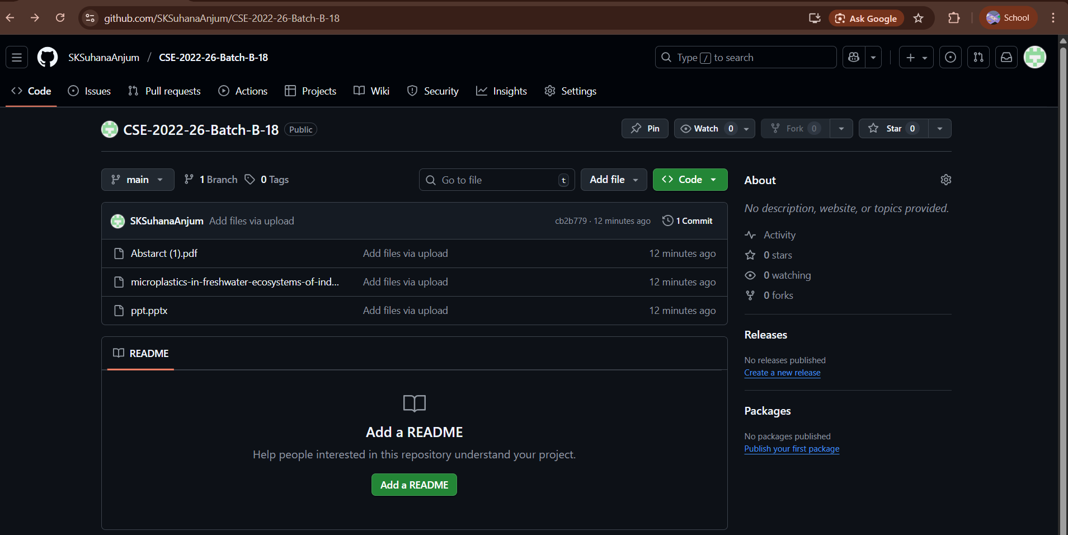
Git Hub Dashboards of each student
Marine Guard
Github link: https://github.com/SKSuhanaAnjum/CSE-2022-26-Batch-B-18
Srinivasa Ramanujan Institute of Technology

Slide 11
Any Queries?
Marine Guard
Srinivasa Ramanujan Institute of Technology

